Slide 1
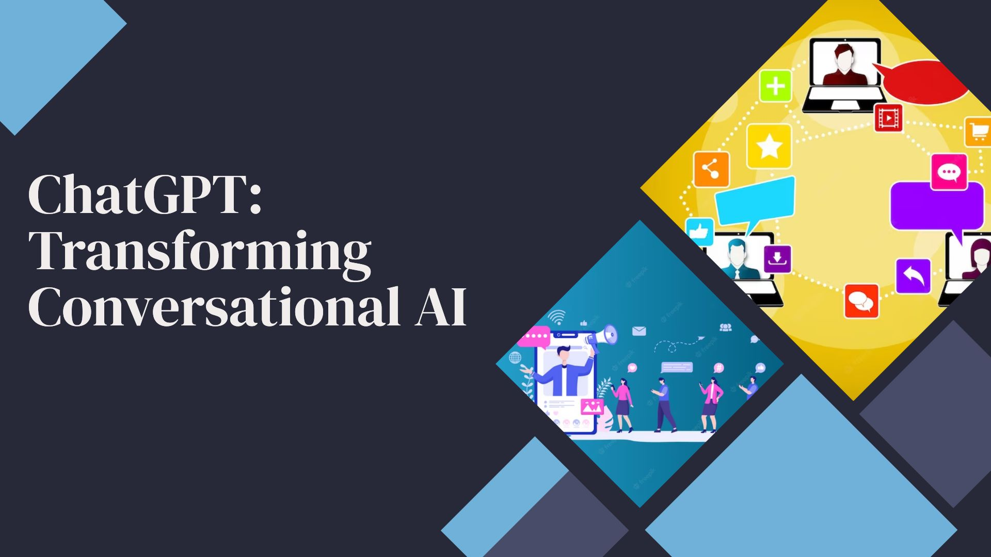

Slide 2


INTRODUCTION
----------------------
CHATGPT is revolutionizing the conversational AI
Landscape by leveraging powerful language models and
Machine learning techniques
IMPORTANCE OF CHAT-GPT
Ability to generate human-like response
ChatGPT opens up new possibilities for virtual assistant
,customer service bots, and more
Understand customer inquires
Business can leverage ChatGPT to create virtual agents
capable of providing personalized support
ChatGPT has acquired an astonishing ability to generate
coherent and contextually relevant responses . Its
learning capabilities enable it to understand and mimic
human cinverstation patterns

Slide 3


Understanding ChatGPT
-----------------------------------------
ChatGPT: An Overview
ChatGPT is a state-of-the-art language model developed by Open Al. It is trained using a large corpus of text data to generate coherent and contextually relevant responses
ChatGPT has the remarkable ability to generate dynamic and adaptive replies that mimic human conversation. It can understand and respond to a wide range of prompts, including questions, statements, and even complex queries.
During pre-training, the model is exposed to an extensive dataset containing parts of the Internet, allowing it to learn grammar, factual information, world knowledge, and the nuances of language usage. This phase equips ChatGPT with a strong foundation for language understanding.

Slide 4


SOFTWARE TOOLS AND REQUIREMENT TO BUILD CHAGPT LIKE CHATBOT
-------------------------------------------------------------
PROGRAMMING LANGUAGES
JAVA
PYTHON
JSP(JAVA SERVLET PROGRAMMING)
HTML,CSS JAVASCRIPT
DEVELOPMENT FRAMEWORK
OpenAI API
PYTORCH
TENSORFLOW
NATURAL LANGUAGE PROCESSING(NLP) LIBRARIES
Libraries such as NTLK (Natural Language Toolkit) spacy , or Hugging Face’s Transformers provide functions for tokenization, part of speech tagging ,entity recognition , and other NLP task
(IDE)s
WEB DEVELOPMENT TOOLS

Slide 5

6) Deployment platforms
Once chatbot is developed , you need a platform to host and deploy it.
Cloud platforms like Amazon Web Services (AWS),
Microsoft Azure , or Google cloud platform (GCP) offer
services for hosting and deploying chatbot applications
7) Version Control System
Version control system like git enable you to track
changes ,collaborate with team members, and
manager different versions of your Chabot codebase.
Platform like GitHub or GitLab provide hosting for Git
repositories.

Slide 6
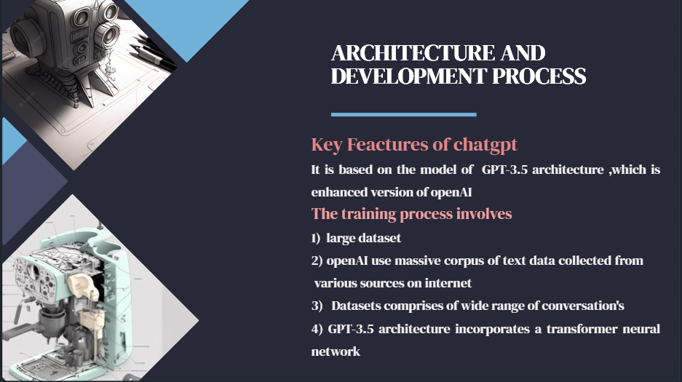

Slide 7

Public Input and Ethical Considerations
---------------------------------------------------
Public input and ethical considerations play a crucial role in the development and deployment of ChatGPT. OpenAI recognizes the importance of incorporating diverse perspectives and addressing potential biases to ensure the responsible and fair use of the technology.
Soliciting Feedback
Bias Mitigation
Ethical Guidelines
Collaboration and Partnerships
OpenAI remains committed to building and deploying AI technologies that are beneficial, safe, and aligned with societal values.

Slide 8
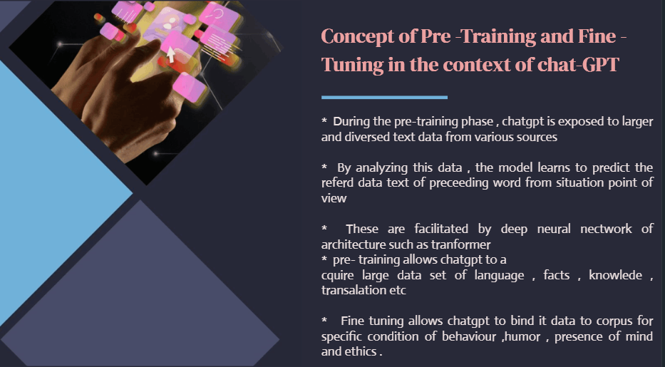

Slide 9
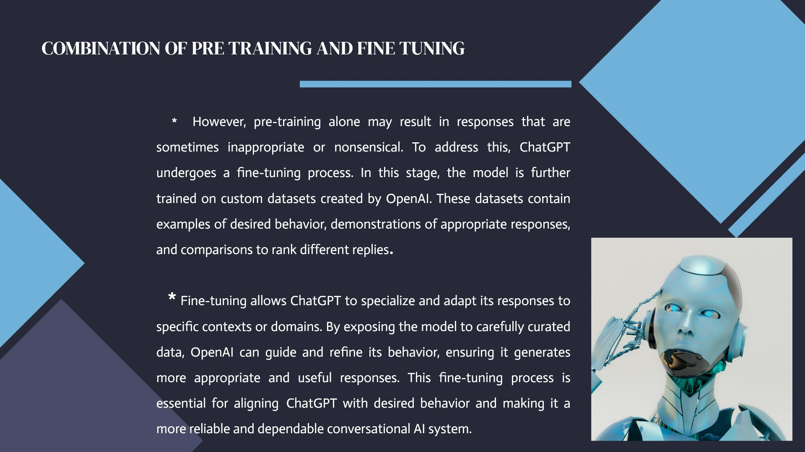

Slide 10
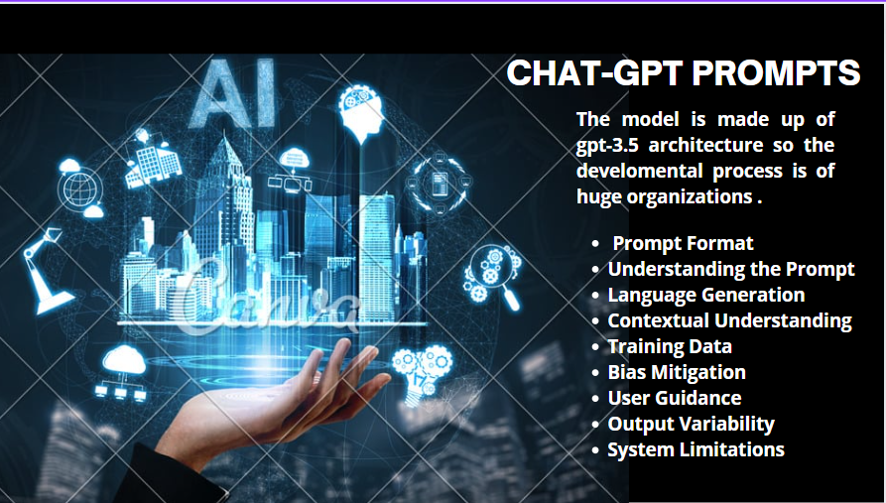

Slide 11
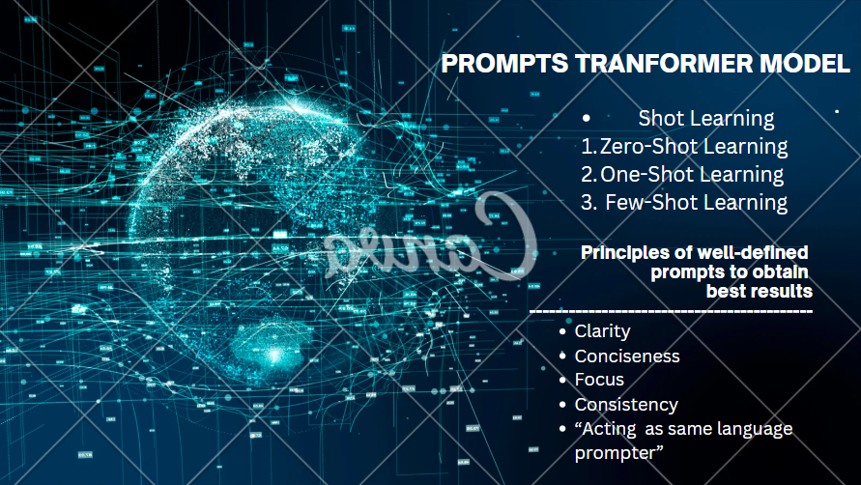

Slide 12


Slide 13
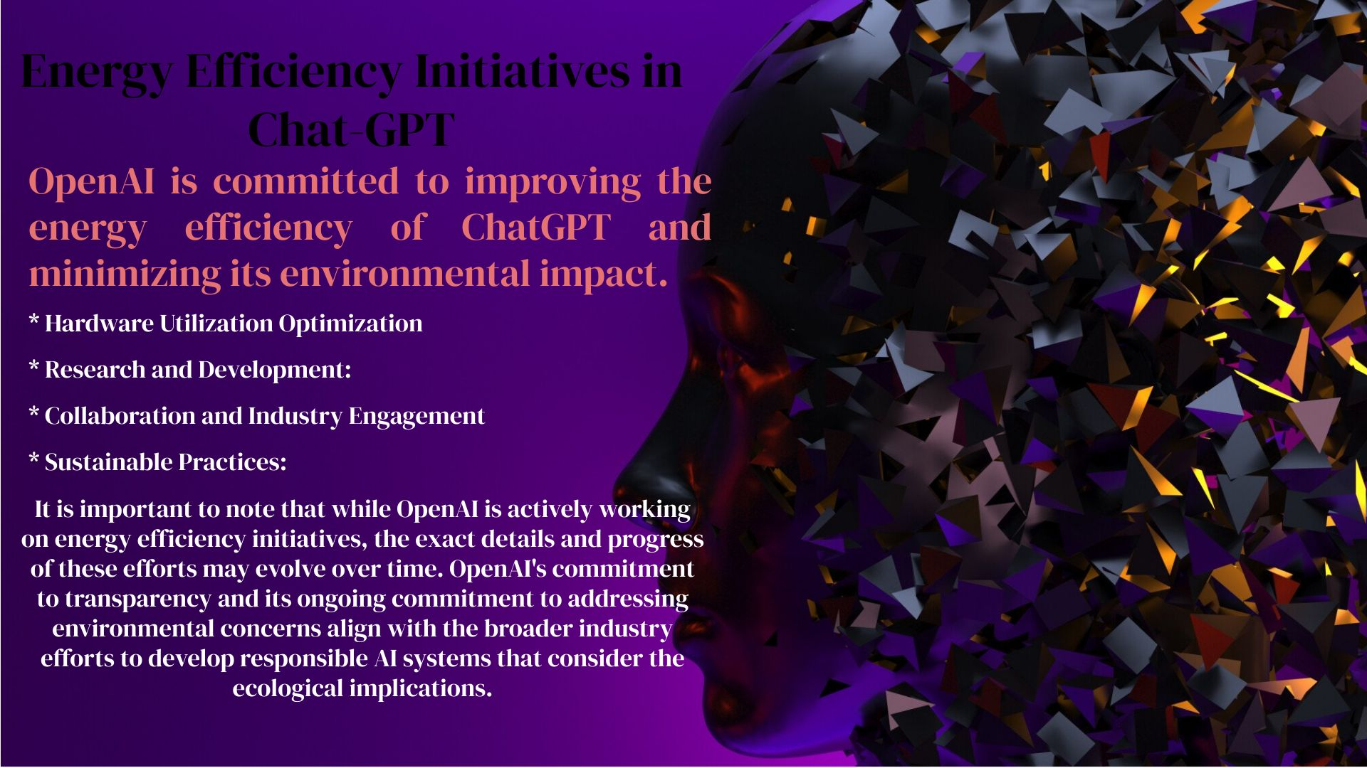

Slide 14
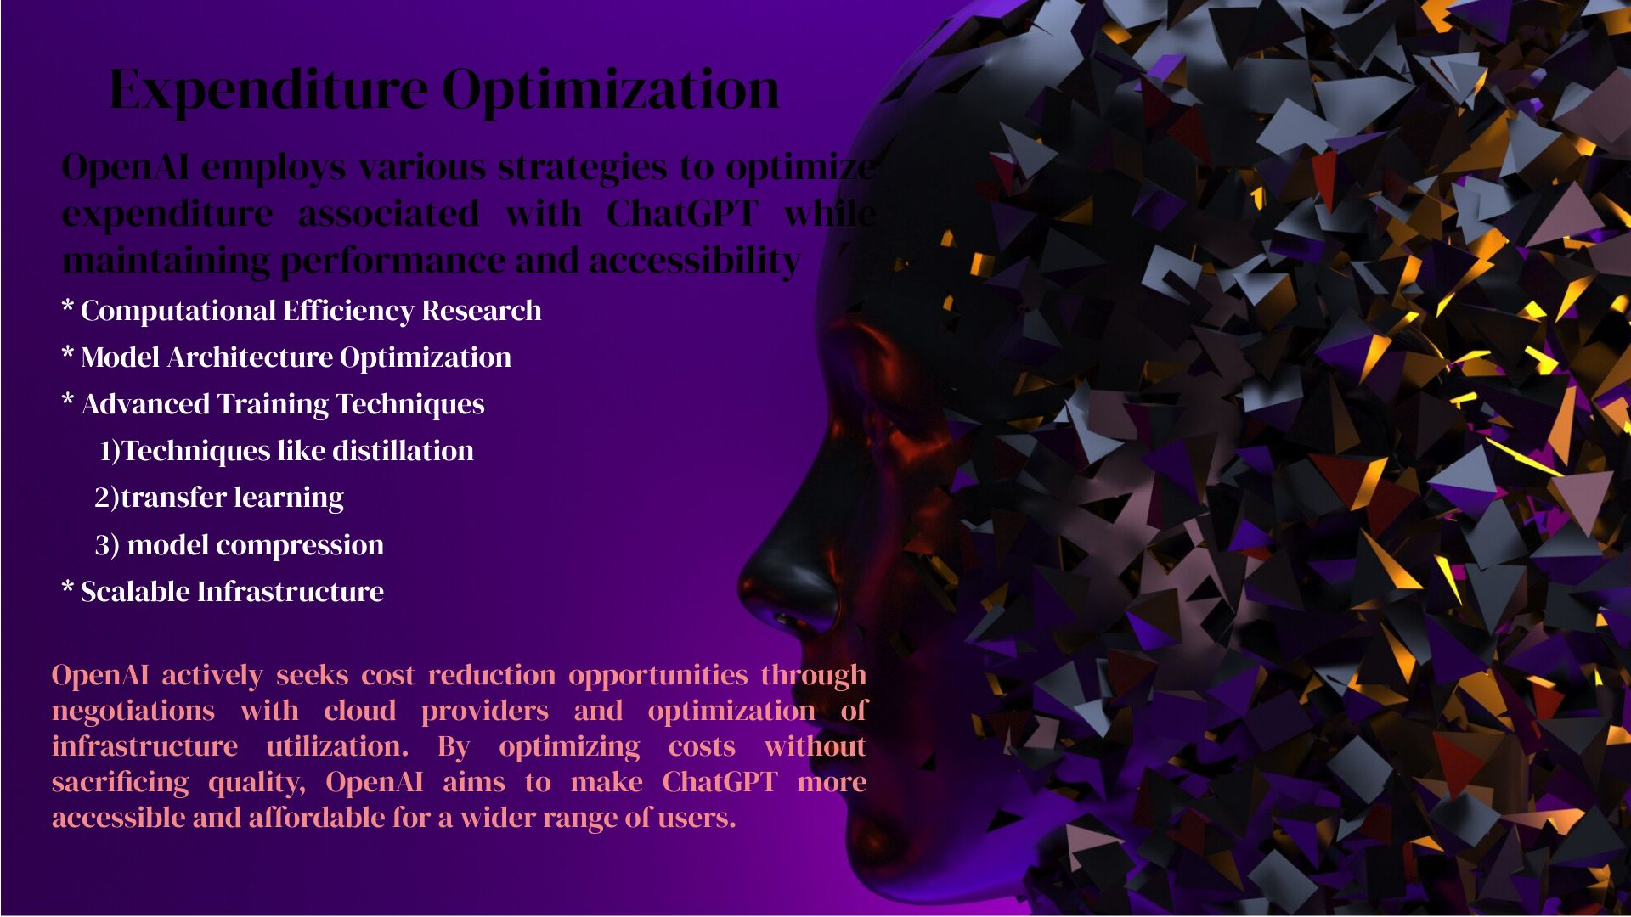

Slide 15

Privacy Policies and User Consent
---------------------------------------------
Privacy policies and user consent are of utmost importance in the development and deployment of AI system like ChatGPT. OpenAI
Recognize the significance of respecting user privacy. Ensuring transparency, and complying with data regulation
Importance of privacy policies and user consent
Transparency and Data Usage Policies
User Consent : OpenAI obtains user consent for data collection
Compliance with data regulations
Accountability and auditing

Slide 16


SECTORS OF WORKING
-------------------------------
Customer Support
Prompt Responses and Availability
Reducing Human Support Staff Workload
Improving Response Time
Virtual Assistants
Personalized Assistance
Integration with Smart Devices
Continuous Learning and Improvement
Content Creation
Idea Generation
Language Refinement
Text to speech and vice-versa
Education and Learning
Creative Writing and Storytelling
Healthcare industry
Diagnosing Patients
Medical Education and Research
Accuracy and Reliability
Privacy and Data Security
Various application of ChatGPT
------------------------------------------
Customer support
Virtual assistant
Content creations
Education and Learning
Creative writing and story telling
Mental Health support

Slide 17

SPECIFIC APPLICATION-PERSONAL SHOPPING ASSISTANT
------------------------------------------------
Understanding User Preferences
users preferences
style
budget
Product Recommendations
Analyze vast amounts of product data
Descriptions, reviews
Assisting with Purchase Decisions
Handling Inquiries and complaints
24/7 Availability and Personalization
Ethical Use of Data

Slide 18

SOME WEBSITES WHICH USES API HANDELLING
-----------------------------------------------------------------------
CHATFUEL (https://chatfuel.com/)
Chat fuel is user-friendly platform that enables you
to build chatbots for Facebook Messenger .It provides
a drag-and-drop interface ,pre-bult templates , and
DIALOGFLOW (https://dialogflow.com/)
Dialog Flow , now part of google cloud ,offers
powerful NLP
MANYCHAT (https://manychat.com/)
Many Chat is a platform specially designed for creating
chatbot like Facebook Messenger .it provides a virtual bot
builder ,automation tool ,integration to create interactive
and engaging experiences
TARS(https://hellotars.com/)
Tars is a chatbot builder that allows you to create
conversational experiences for websites and landing pages
Land Bot(https://landbot.io/)

Slide 19


OUR WORKPLAN AND
INITIAL FINDINGS
----------------------------------
Our plan is to build an AI chatbot which will be train to our specific dataset with the help of
Pre – Training
Fine – Tuning
The integration of CHATGPT API in our chatbot (OpenAI)
Testing and iteration
Monitoring and Maintenance
Prompt engineering response and training
with GPT-3.5 architecture
Deployment of model and chatbot which respect
user privacy and data security
Data processing and Data augmentation
Dataset size and quality
Maritime logistic related application
Customer Support
Booking and Documentation
Freight Rate Calculations

Slide 20


